Slide 1

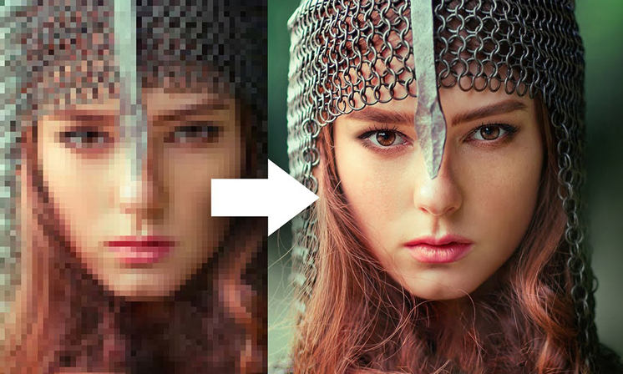
Image Enhancement with Super-Resolution and Controlled Noise
24-1-R-12
Students: Liza Shvachka
Avishai Hershkovitz
Supervisor: Dr. Renata Avros
Notes:
אבישי

Slide 2
Problem
Many Existing models of Image Enhancement rely on clean images for restoration, which are sometimes unavailable.
Real images are usually are influenced by many external not controlled factors.

Slide 3
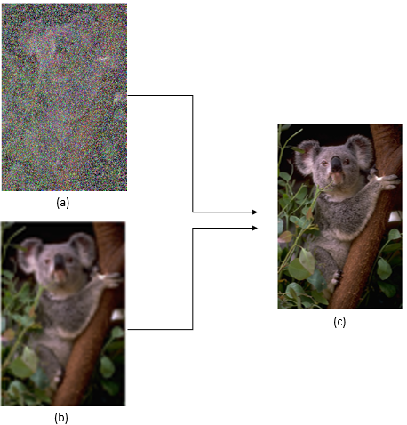
Suggested Solution
Enhance image quality by increasing resolution and removing noise based only on corrupted images.
Utilize Deep learning model Noise2Noise employing U-net.
Apply Super Resolution Deep learning model using RU-net.

Slide 4
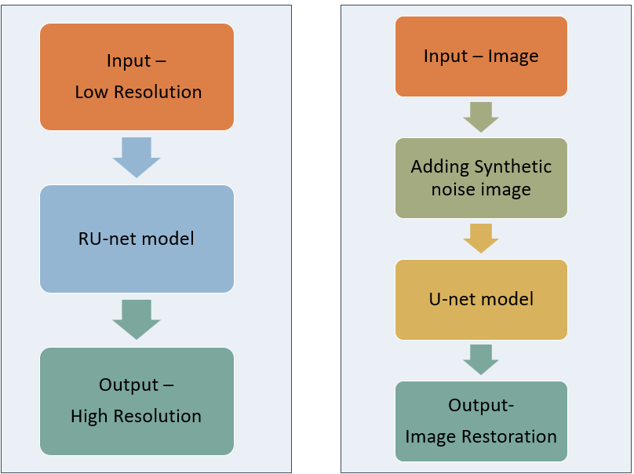
Super Resolution
Noise2Noise
Models

Slide 5
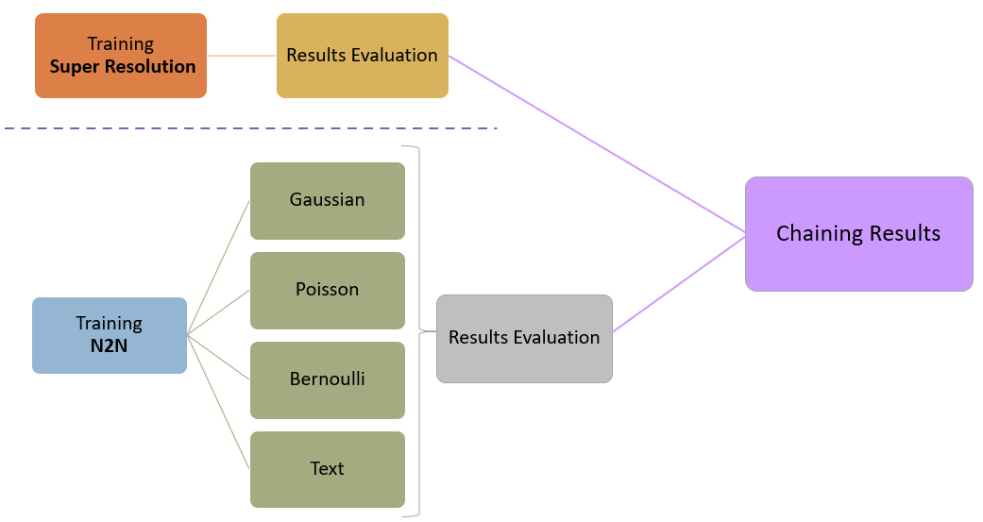

The Process

Slide 6
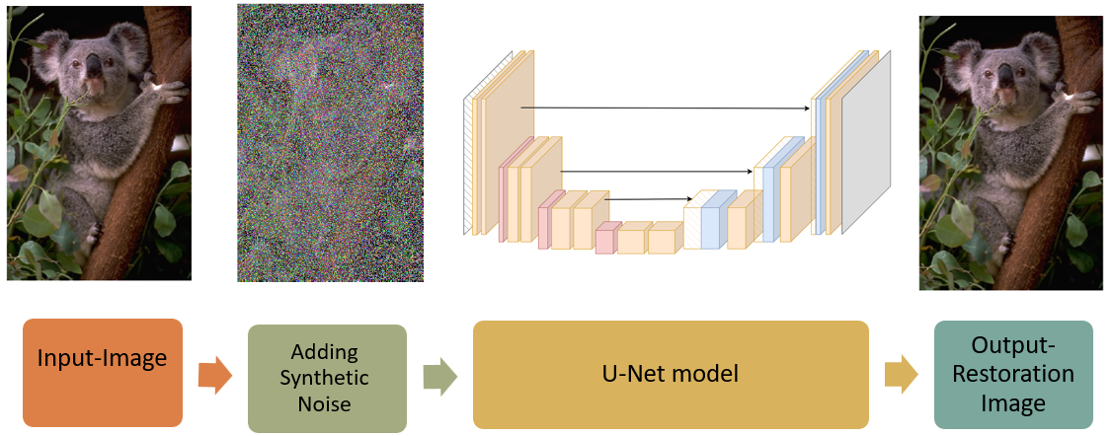
Noise2Noise- Train Process
Input: Image from various sources.
Adding Synthetic Noise: Simulating real-world conditions.
U-net Model Training: Iteratively mapping noisy to clean images.
Output: High-resolution image with minimized noise.

Slide 7
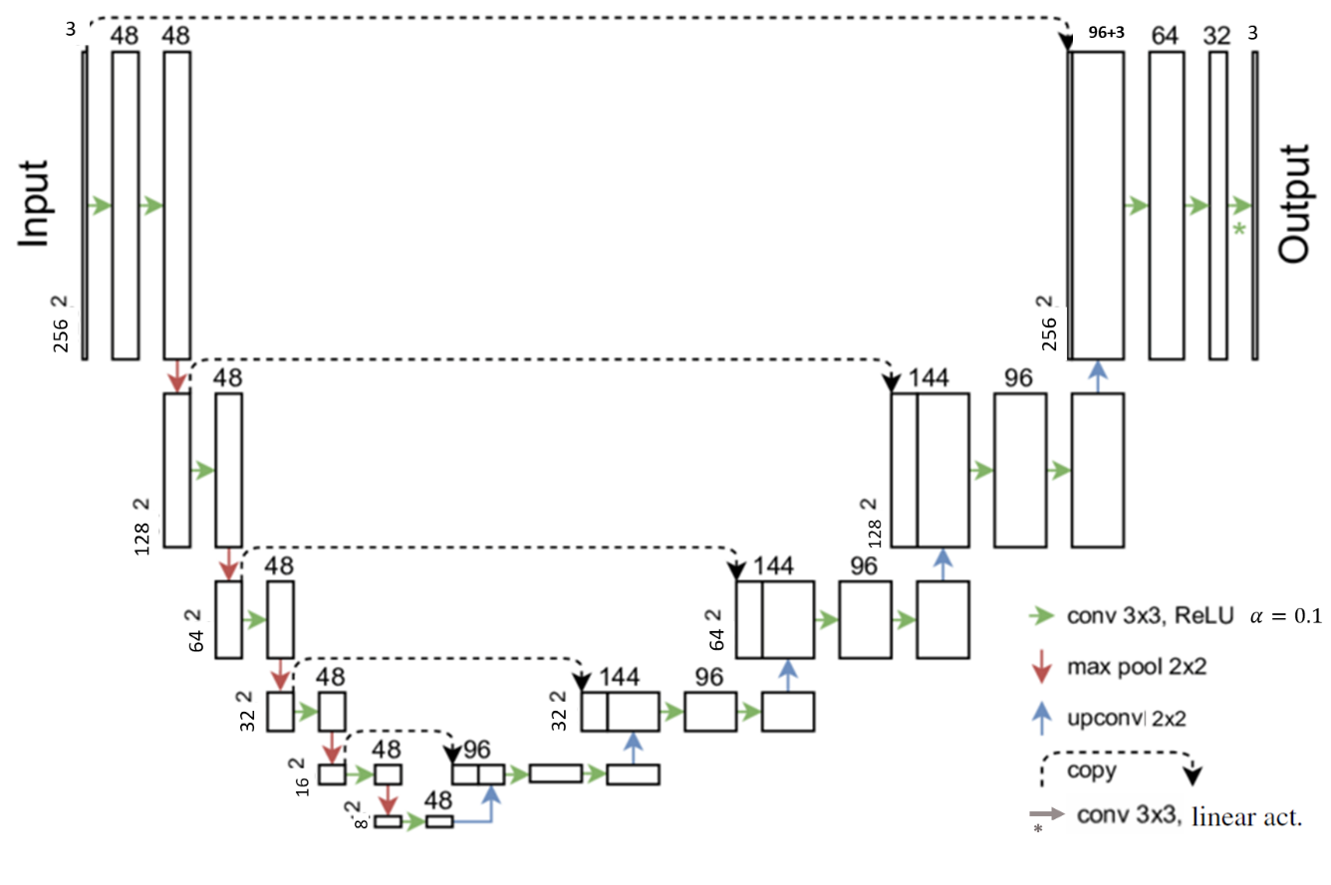
U-net architecture

Slide 8
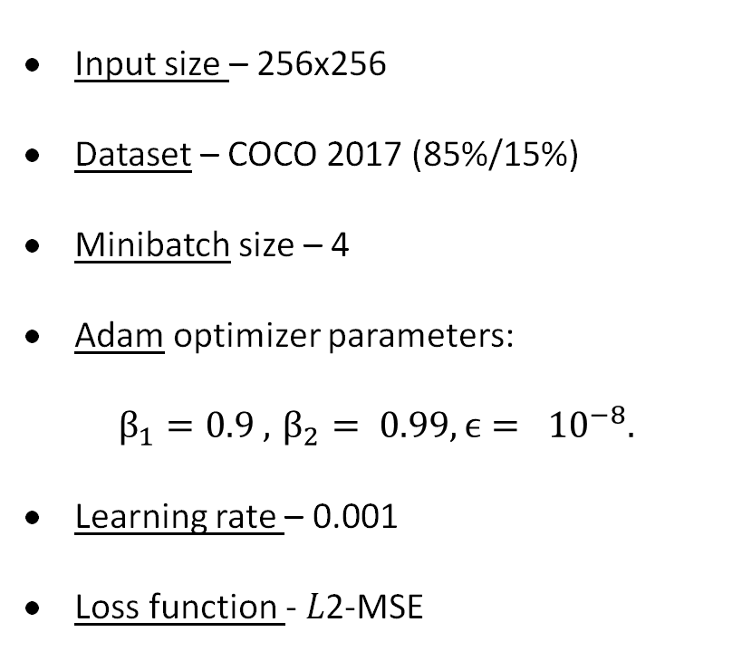
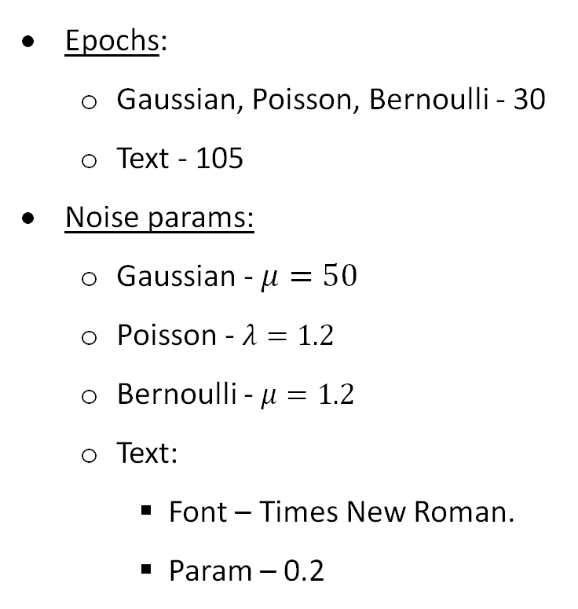
Hyperparameters
Input size – 256x256
Dataset – COCO 2017 (85%/15%)
Minibatch size – 4
Adam optimizer parameters:
$$β_{1}=0.9 , { β}_{2} = 0.99, ϵ= {10}^{−8}.$$
Learning rate – 0.001
Loss function - 𝐿2-MSE
Epochs:
Gaussian, Poisson, Bernoulli - 30
Text - 105
Noise params:
Gaussian - $μ=50$
Poisson - $λ=1.2$
Bernoulli - $μ=1.2$
Text:
Font – Times New Roman.
Param – 0.2

Slide 9
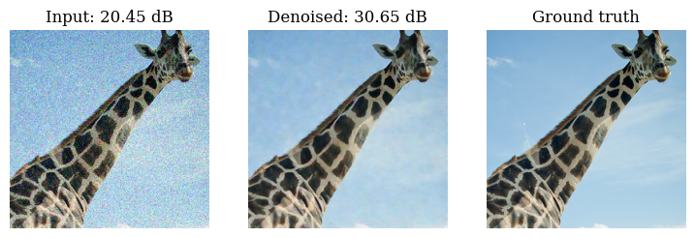
Examples Results- Gaussian noise
Noisy Image
Denoised Image
Clean Image

Slide 10
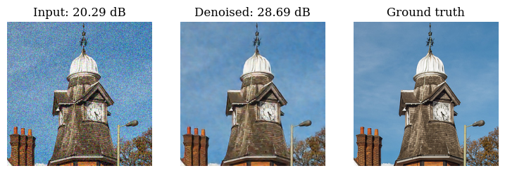
Examples Results-Gaussian noise
Noisy Image
Denoised Image
Clean Image

Slide 11
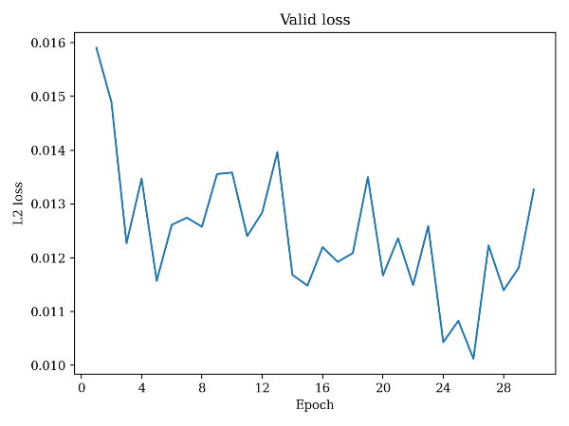
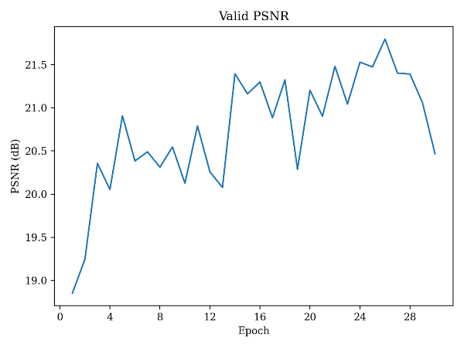
Metrics- Gaussian noise
Validation loss
Validation PSNR

Slide 12
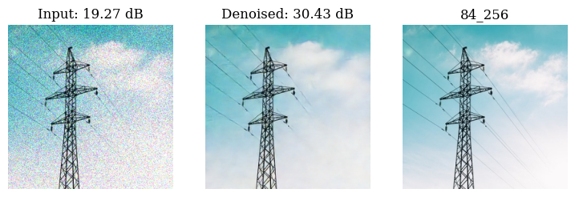
Examples Results- Poisson noise
Noisy Image
Denoised Image
Clean Image

Slide 13
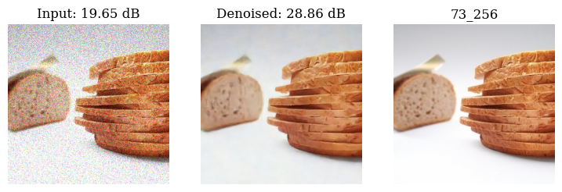
Examples Results- Poisson noise
Noisy Image
Denoised Image
Clean Image

Slide 14
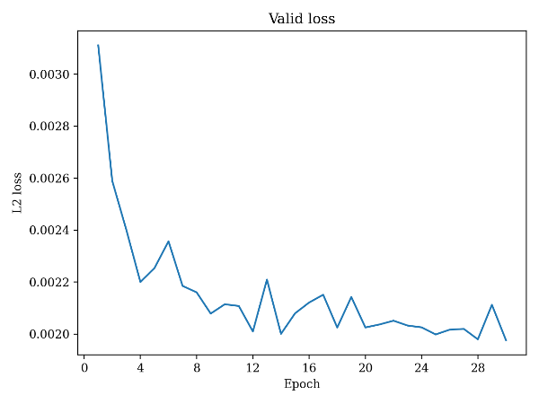
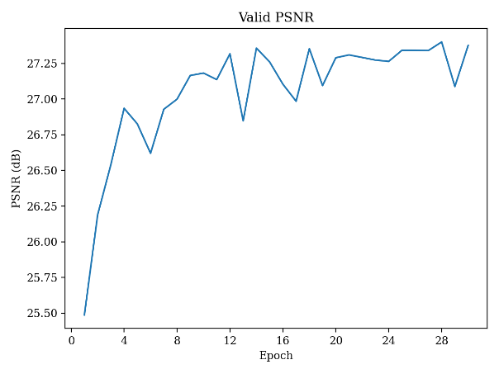
Metrics- Poission Noise
Validation loss
Validation PSNR

Slide 15
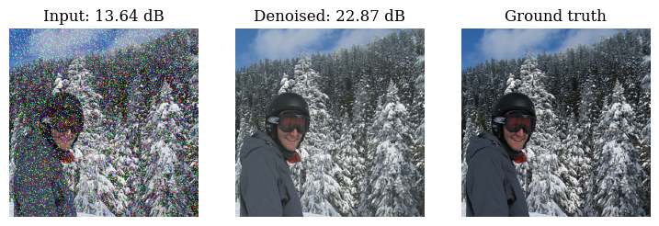
Examples Results- Bernoulli noise
Noisy Image
Denoised Image
Clean Image

Slide 16
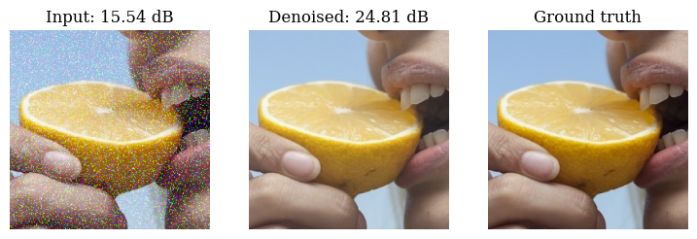
Examples Results- Bernoulli noise
Noisy Image
Denoised Image
Clean Image

Slide 17
Metrics- Bernoulli Noise
Validation loss
Validation PSNR

Slide 18
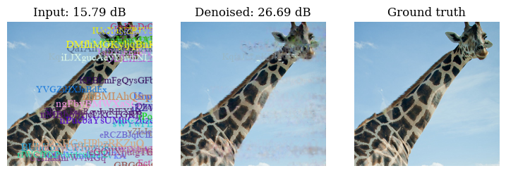
Examples Results- Text Overlay
Noisy Image
Denoised Image
Clean Image

Slide 19
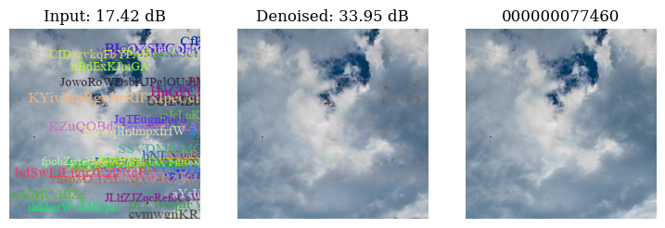
Examples Results- Text Overlay
Noisy Image
Denoised Image
Clean Image

Slide 20
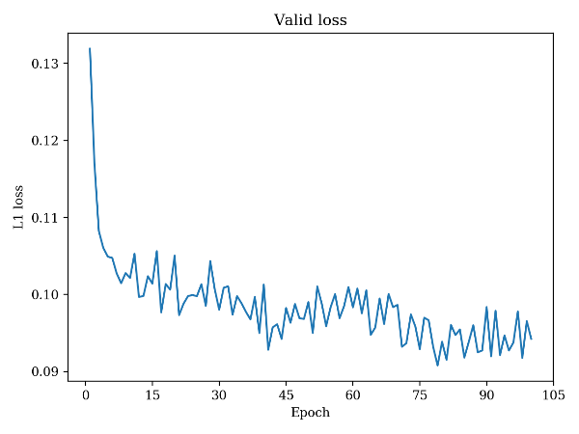
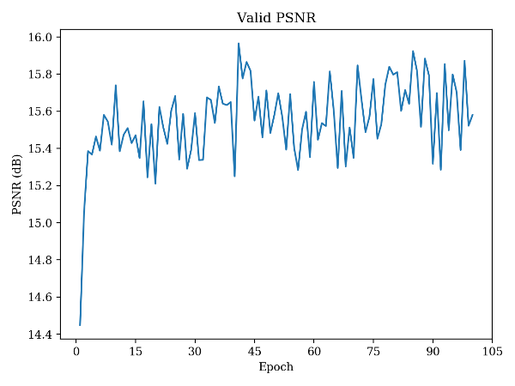
Metrics- Text Overlay
Validation loss
Validation PSNR

Slide 21
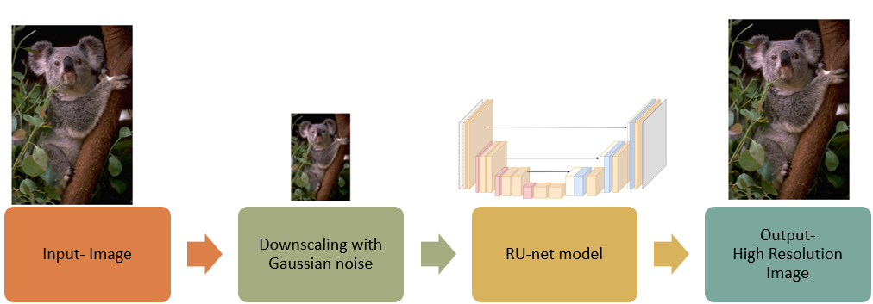
Super Resolution- Train Process
Input: High-resolution images.
Synthetic Low-Resolution: down-sampled, blurred, up-sampled.
RU-net Model Training: A robust U-net architecture.
Output: High-resolution images and visual enhancement.

Slide 22
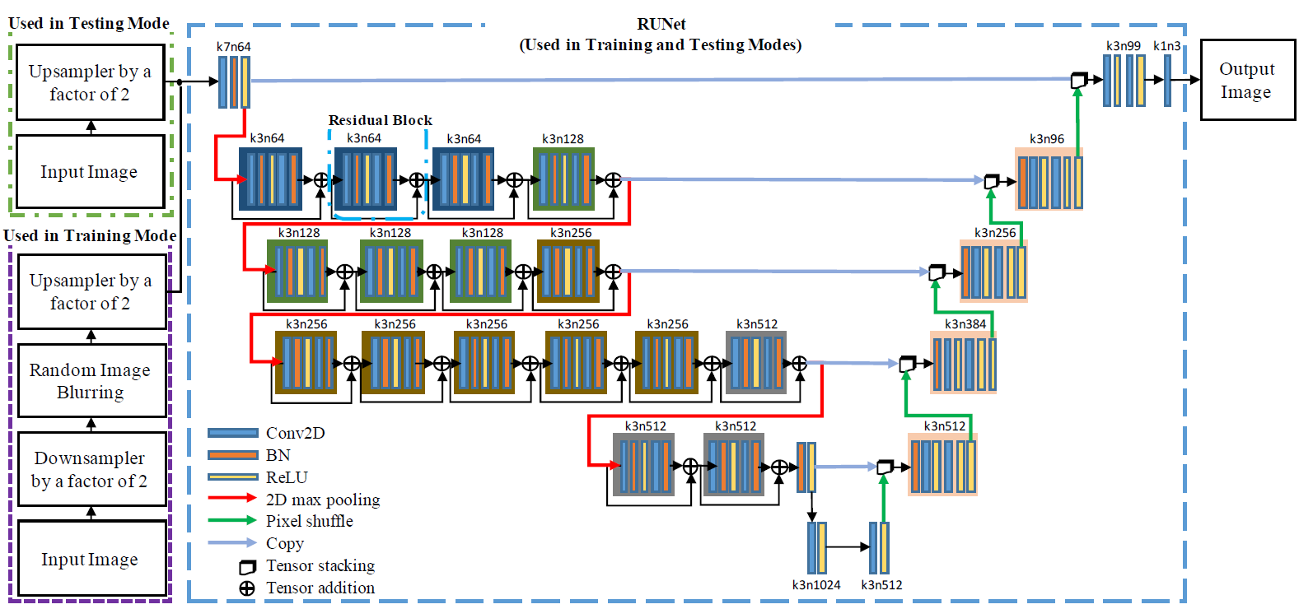
RU-net architecture

Slide 23
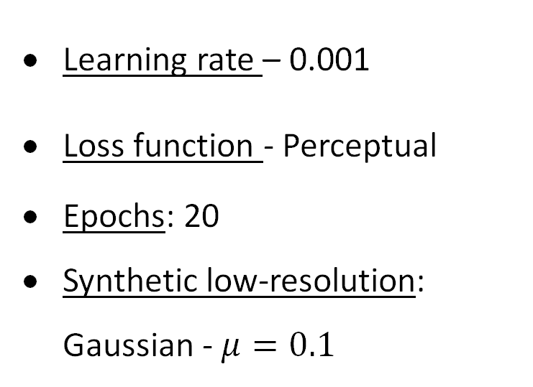
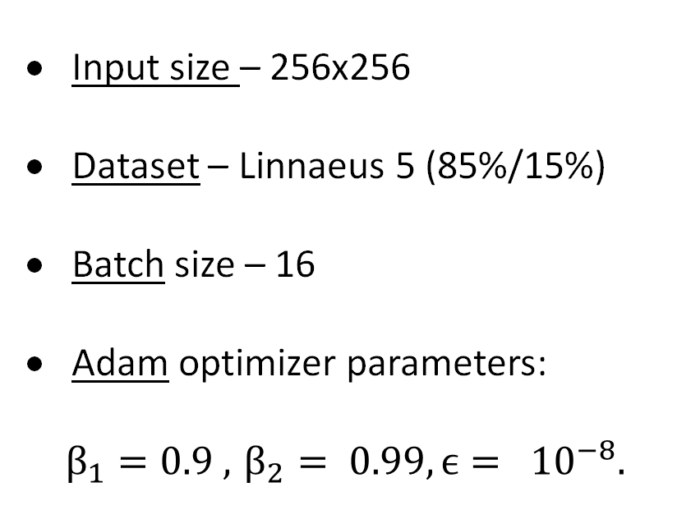
Hyperparameters
Input size – 256x256
Dataset – Linnaeus 5 (85%/15%)
Batch size – 16
Adam optimizer parameters:
$$β_{1}=0.9 , { β}_{2} = 0.99, ϵ= {10}^{−8}.$$
Learning rate – 0.001
Loss function - Perceptual
Epochs: 20
Synthetic low-resolution:
Gaussian - $μ=0.1$

Slide 24
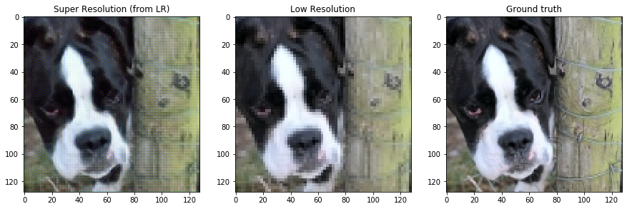
Examples Result
Super Resolution
Low Resolution
Ground truth

Slide 25
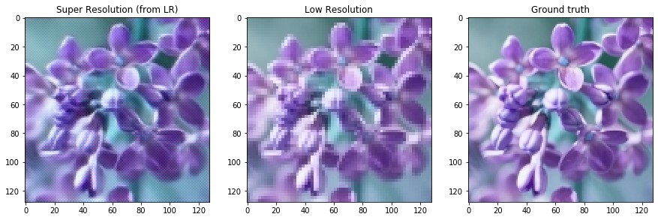
Examples Result
Super Resolution
Low Resolution
Ground truth

Slide 26
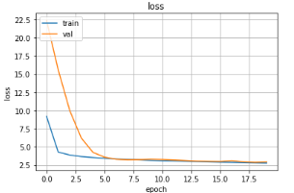
Metrics- Super Resolution
Validation loss
Notes:
אבישי

Slide 27
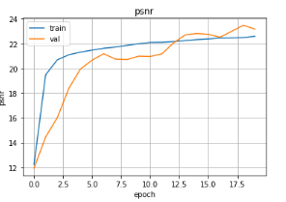
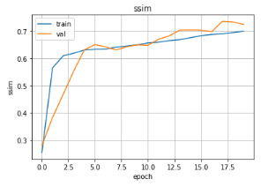
Metrics- Super Resolution
Validation PSNR
Validation SSIM
Notes:
אבישי

Slide 28
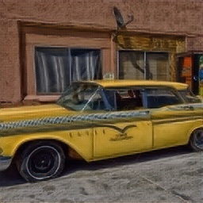
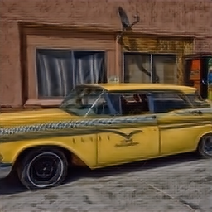
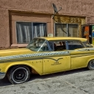
Result Chaining
Combining models' results, the first model's output serves as the second model's input
Clean Low Resolution
High Resolution
N2N- Poisson

Slide 29
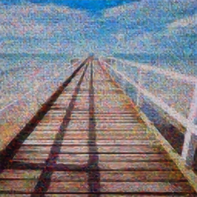
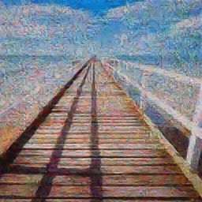
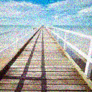
Result Chaining
Combining models' results, the first model's output serves as the second model's input
Noisy Low Resolution
High Resolution
N2N- Gaussian

Slide 30

The Product

Slide 31

Expected Achievements
Improve Super-resolution.
Clean corrupted image techniques without explicit data.
Integrating both models into a unified model.

Slide 32
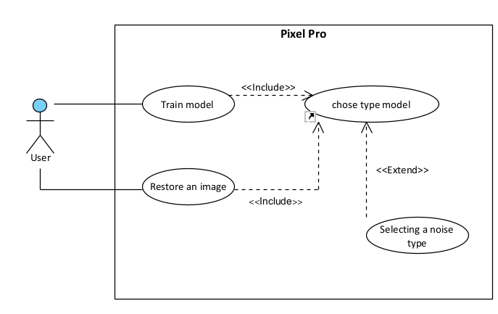
Use Case

Slide 33
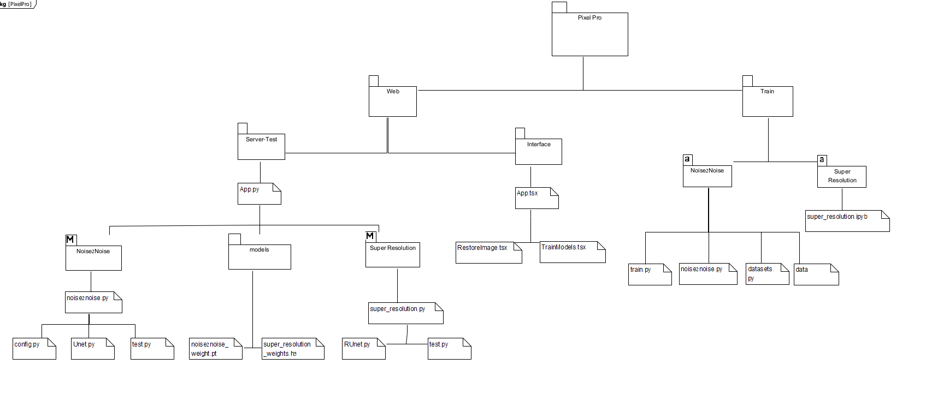
Package

Slide 34
Test process
Excepted result | Test description | Module
Open 'Train Models' window | Click 'Train Models' in sidebar menu | Home page
Open 'Restore an image' window | Click 'Restore an image' button in sidebar menu | Home page
Open 'Upload dataset' window | Click 'Upload dataset' button in sidebar menu | Home page
Option ‘Super resolution' should be chosen. | Click on combo box 'Type of model' and choose 'Super resolution' | Train Models window>Type of Model
Option ‘Gaussian' should be chosen | Click on combo box 'Type of noise' and choose 'Gaussian' | Train Models window ->Type of model (Noise2Noise)->Type of noise
Option ‘Poisson' should be chosen | Click on combo box 'Type of noise' and choose 'Poisson' | Train Models window ->Type of model (Noise2Noise)->Type of noise
An alert in red will pop up with message 'one or more fields are not chosen' | Click on 'Train' button (failure case: One or more combo box not chosen) | Train Models window
Open the file explorer to select the files | Click on ‘Browse for file' | Restore an image window->Upload image
Advance to step of Clear image processing with active precent of the clear | Click on button 'Start process' | Restore an image window->Clear image
Download the clean image to your computer | Click on button 'download' | Restore an image window->Finish process

Slide 35

Thanks for your attention!
Liza Shvachka
Avishai Hershkovitz

